Slide 1






Detecting Spam Emails
Student Details
Name: R.janapriya
NM Id: au61772111040
College Name: GOVERNMENT COLLEGE OF ENGINEERING, SALEM

Slide 2
Disclaimer
The content is curated from online/offline resources and used for educational purpose only

Slide 3

CONTENTS
Abstract
Problem Definition
Objective
Introduction
Litrature survey
Content diagram
Conclusion

Slide 4

Abstract
. Email is an information stored on a computer that is exchanged between two users over telecommunication
. Spam is one of the major threats posed to email users.spam refers to the electronic messaging system to send out unrequested or unwanted message in bulk
. The privacy and security of large amount of sensitive data are thread by malicious sapm
. Data mining has many aproaches and alogrotis for email filtering. A classifier is a supervised function where the learned attribute is categorical
. Context based methods analyze the control of the email to determine if the email is spam or not

Slide 5

Problem Definition
Each email provider has their own filtering system or technique, but most of them don’t work to their
full capacity.
The cyberpunks use emails to obtain valuable credentials.
There is no integrated approach for classifying and filtering a mail as a spam or a legitimate.
Data intergration is a preprocessing technique that involves combining data

Slide 6

Objective
To compare the accuracy of the classifiers and introduces the best classifier fordetecting mails.
We use different data mining techniques classifiers like Naive Bayes, KNN, DecisionTree, Logistic Regression to categorize a mail into spam or legitimate.

Slide 7
INTRODUCTION
Email is one of the crucial aspects of web data communication.
Spam emails are the emails that the receiver does not wish to receive. Spammessages notonly increases the network communication and memory space but can also be used for someattack.
Spamming is actually done by sending unsolicited bulk messages to indiscriminate set ofrecipients for advertising purpose.
The spam filter is a basic filter mechanism that is used to control the spam in the email

Slide 8

Proposed Solution
Solution Proposed Solution means the combination of software, hardware, other products or equipment, and any and all services (including any installation, implementation, training, maintenance and support services) necessary to implement the solution described by Vendor in its Proposal
Notes:
8

Slide 9
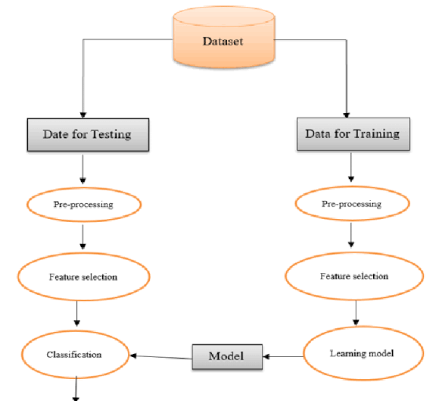
System Deployment Approach
Notes:
9

Slide 10
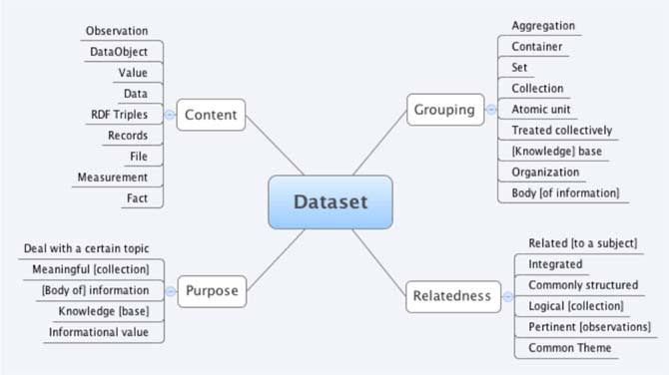
Model Development & Algorithm
Dataset Description:
Notes:
10

Slide 11
Model Development & Algorithm
Algorithm:
The specifications derived earlier in the analysis phase are translated into the algorithm. An algorithm is a step-by-step sequence of precise instructions that must terminate and describes how the data is to be processed to produce the desired outputs. The instruction may be expressed in a human language.
• An algorithm must satisfy some requirements:
• Input
It must have zero or more input
• Output
It must produce at least one output.
• Definiteness
Every step in algorithm must be clear as to what it is supposed to do and how many times it is expected to be executed.
• Effectiveness
It must be correct and efficiently solve the problem for it is designed.
• Finiteness
It must execute its instruction and terminate in a finite time.
Notes:
11

Slide 12
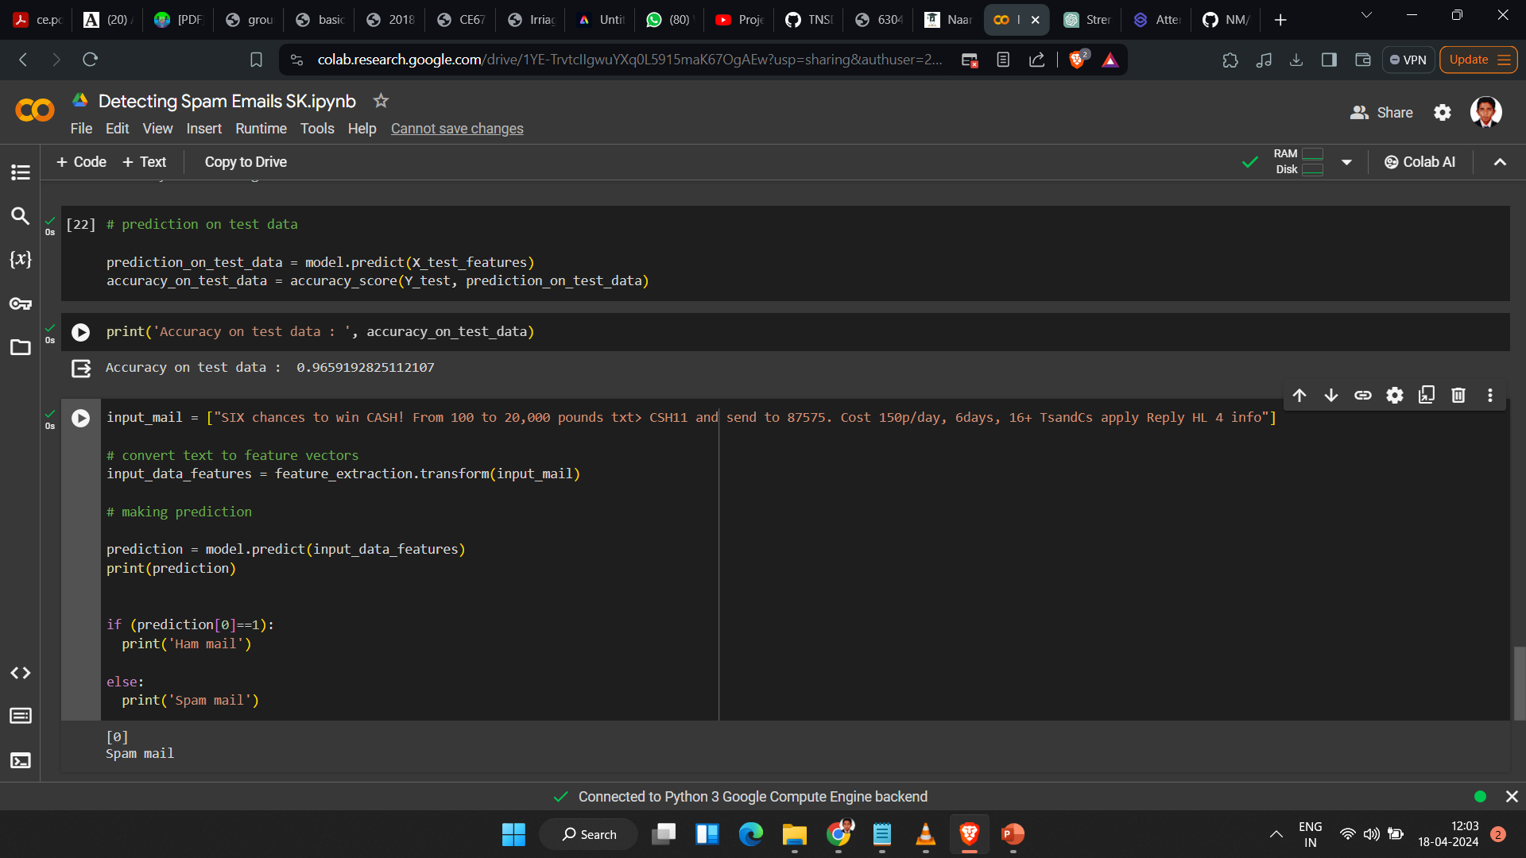
Result
Notes:
12

Slide 13

Future Scope
.Future Scope creates opportunities and solves problems for customers tackling the complexities of building commercial grade solutions.
.The stakes are high in commercial environments. Quality is paramount.
Release schedules are demanding. Cost control is critical.
.This vision stimulated the purpose of Future Scope as we began in 2007. Since that time we have been engaged by large enterprises, software vendors, and technology startups.
Notes:
13

Slide 14
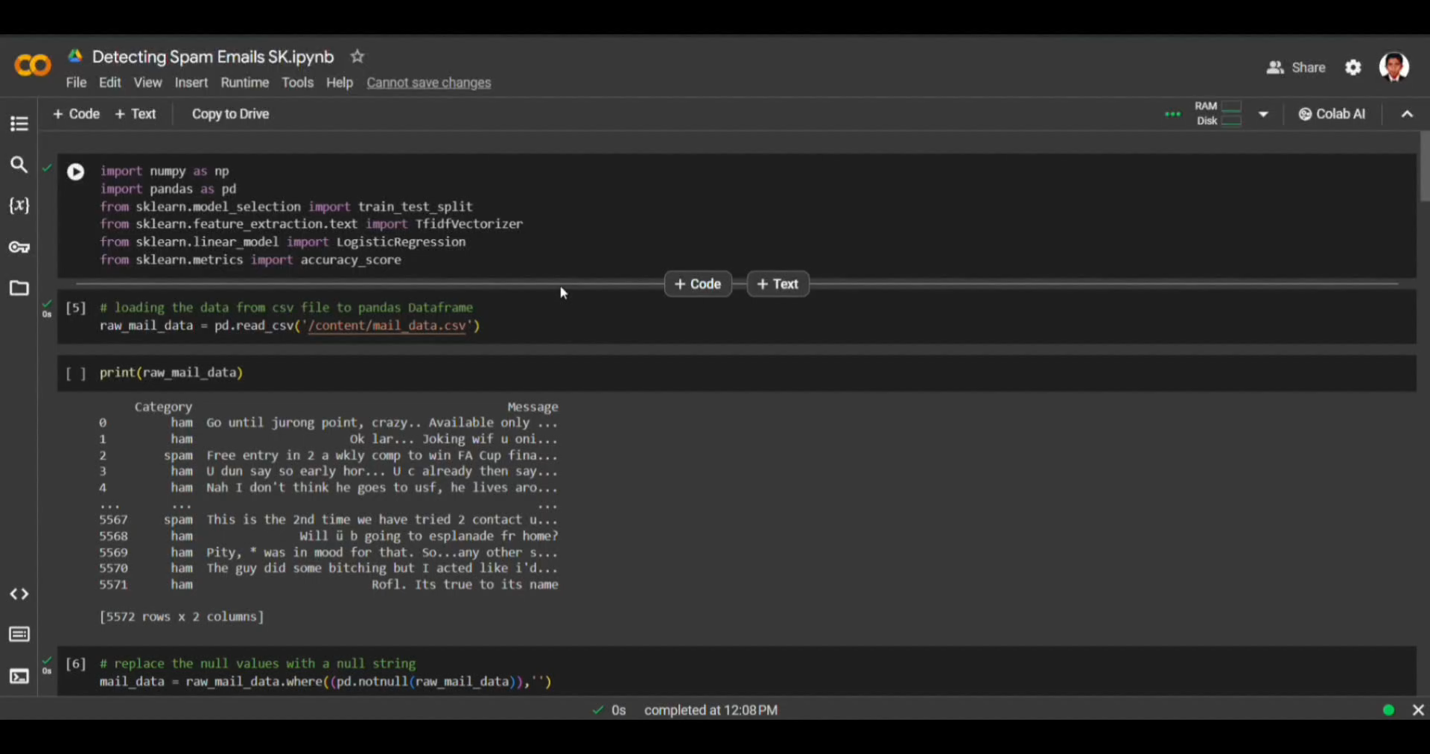
Video of the Project
Notes:
14

Slide 15

Conclusion
. It was found that phosphoric acid etching will not degrade electrical properties of the devices. It was also found that we can enhance the LED output intensity by 30% using phosphoric acid etching.
Notes:
15

Slide 16
Reference
https://www.coursera.org/
https://www.udacity.com/
https://www.kaggle.com/learn
https://codelabs.developers.google.com/
Notes:
Reference
These are the references for this session.

Slide 17
Thank you!
Notes:
17

